Slide 1
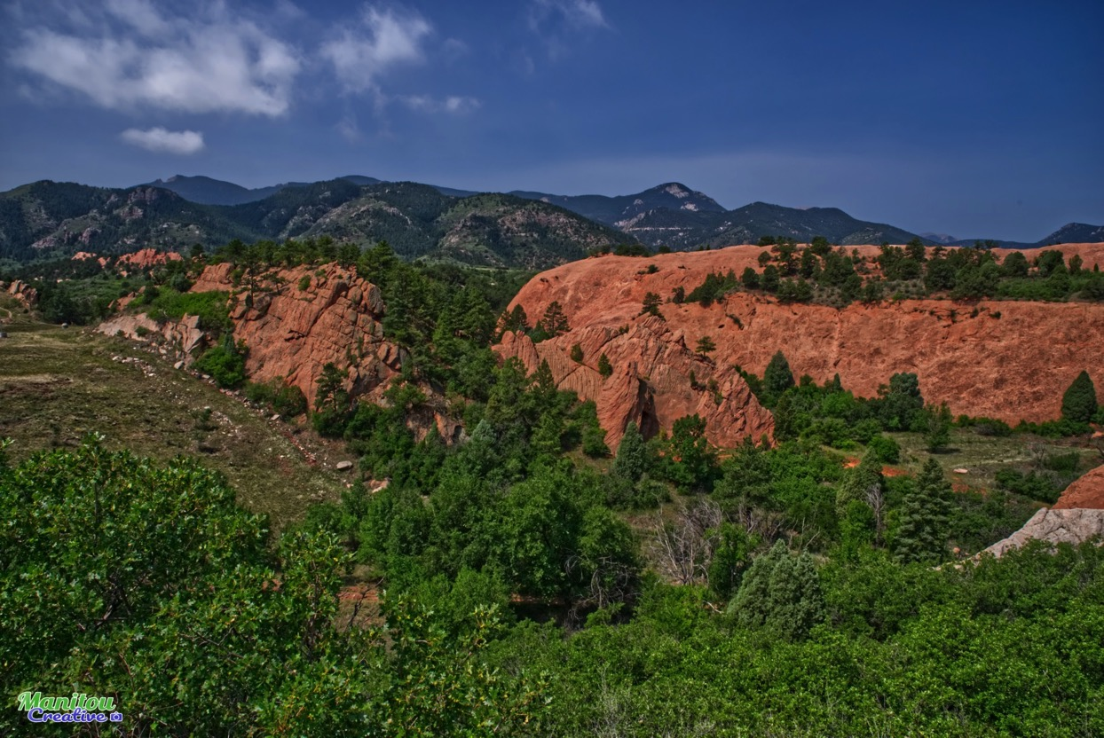
Red Rock Canyon Heart Connection

Slide 2
In the middle of our public open space there is a special opening between the grand red rocks

Slide 3
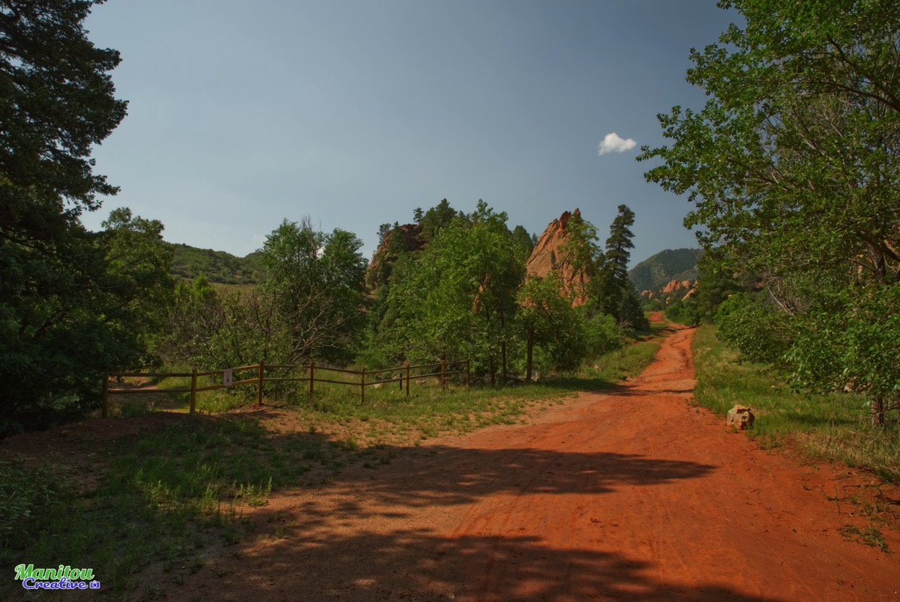
It connects the Gypsum Canyon to the Red Rock Canyon.
It is the natural place for a beautiful trail.

Slide 4
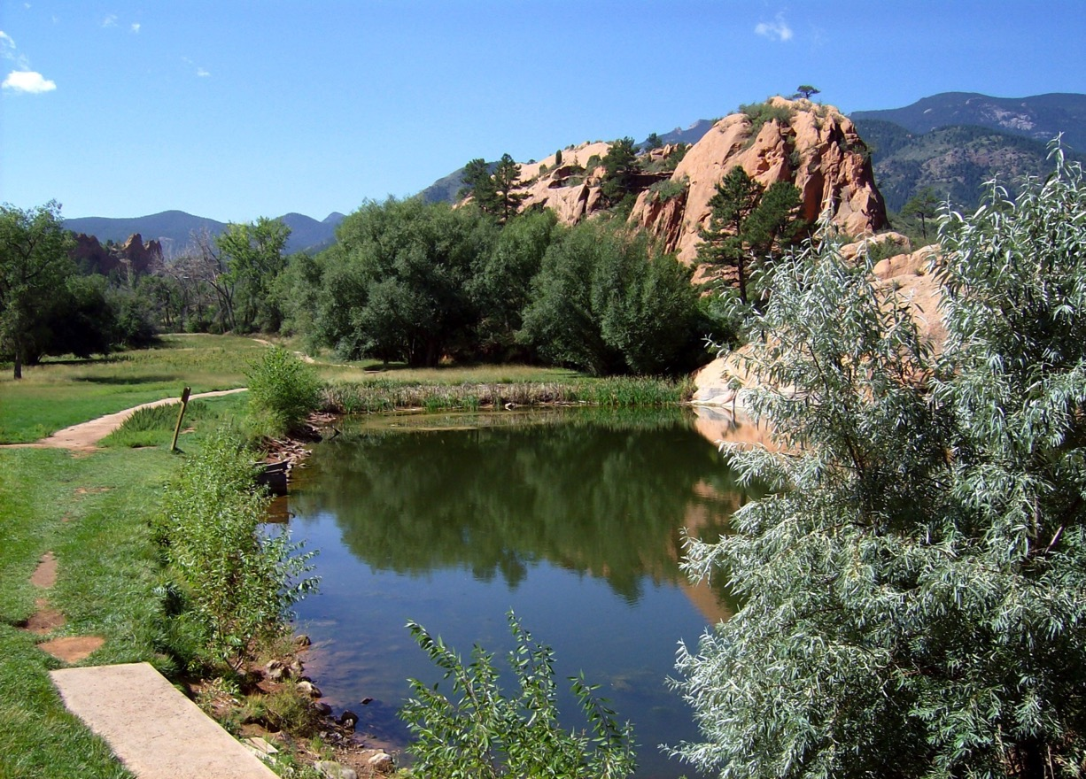
We call it the Heart Of The Canyon, because water from the two canyons flow together down to the ponds.

Slide 5
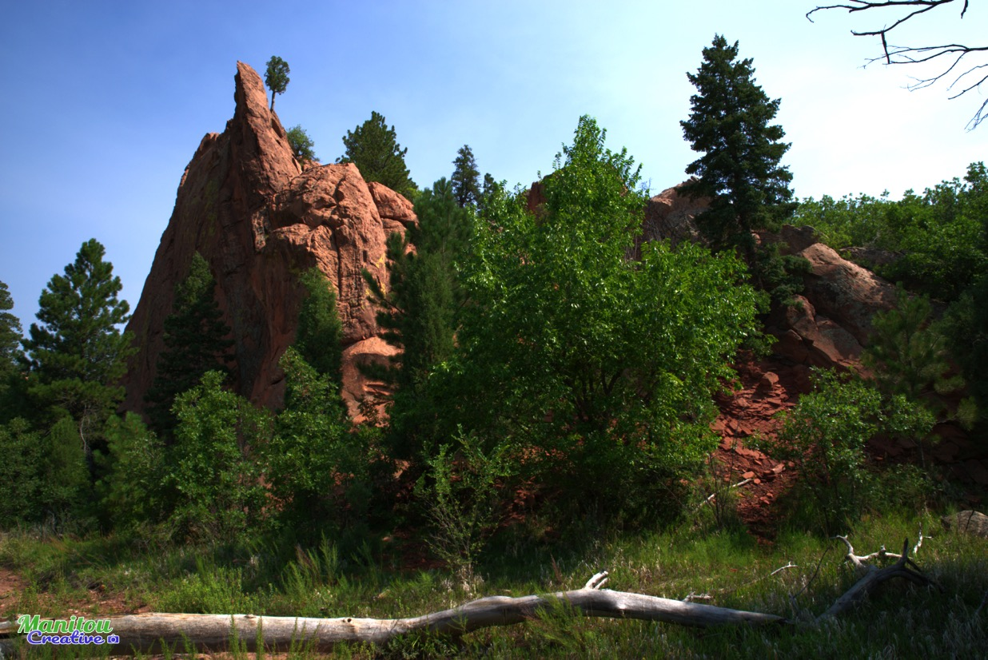
This natural connection between the canyons is one of the most beautiful parts of our open space.

Slide 6
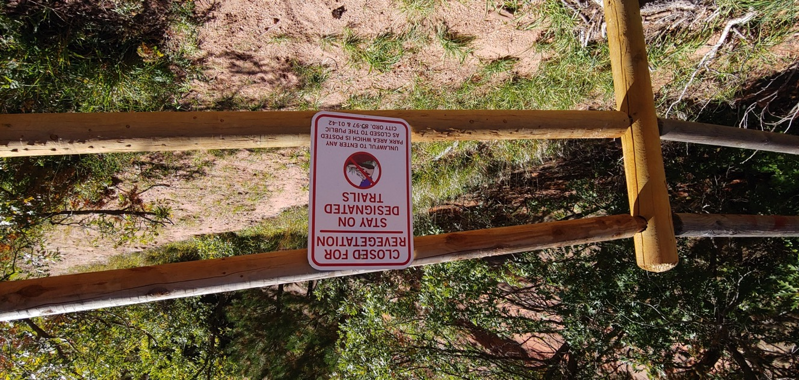
Sadly, no one is permitted to enjoy it, because the area has been damaged and marked as permanently closed. Why?

Slide 7
Current plans leave the problems caused by dumping, quarrying, and erosion for future generations.

Slide 8
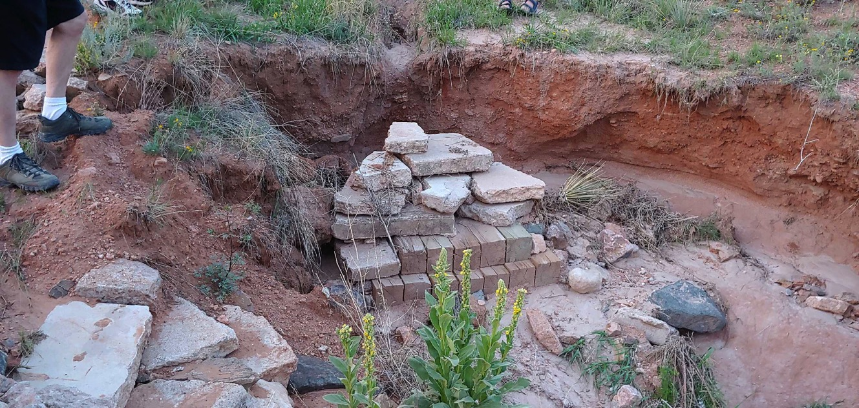
We need have some heavy equipment to
stabilize and redirect water drainage.

Slide 9
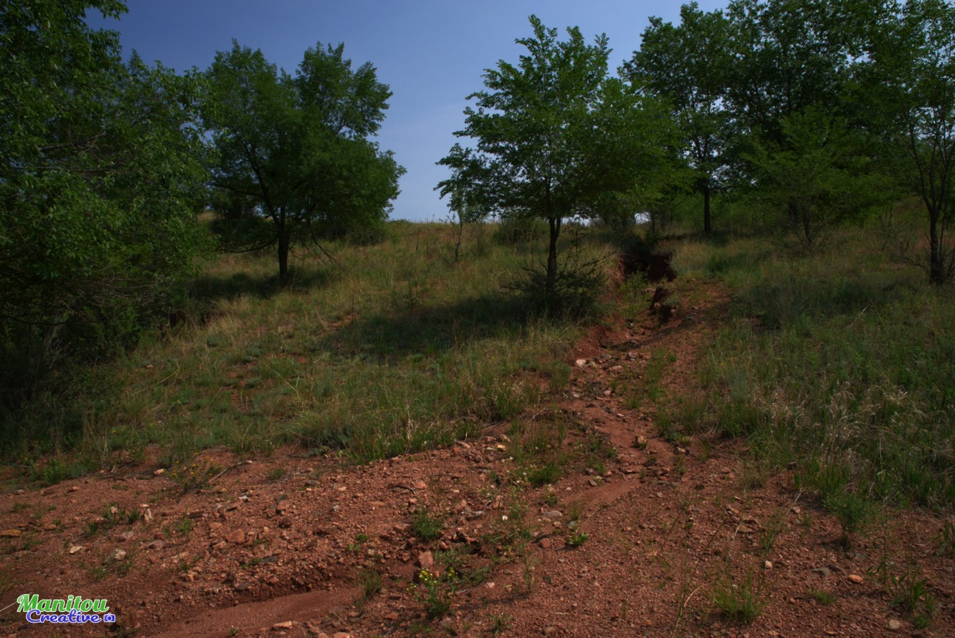
We can remediate deeply eroded gullies and channel the water away from the trail.

Slide 10
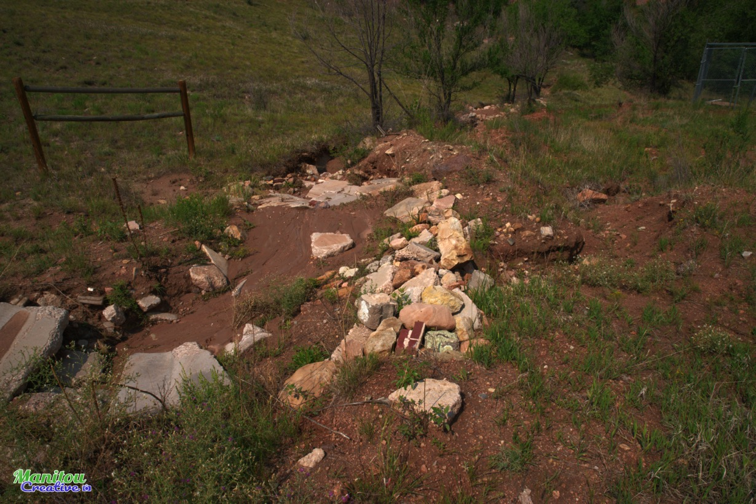
Let’s fix storm water management problems and keep people off the landfill.

Slide 11
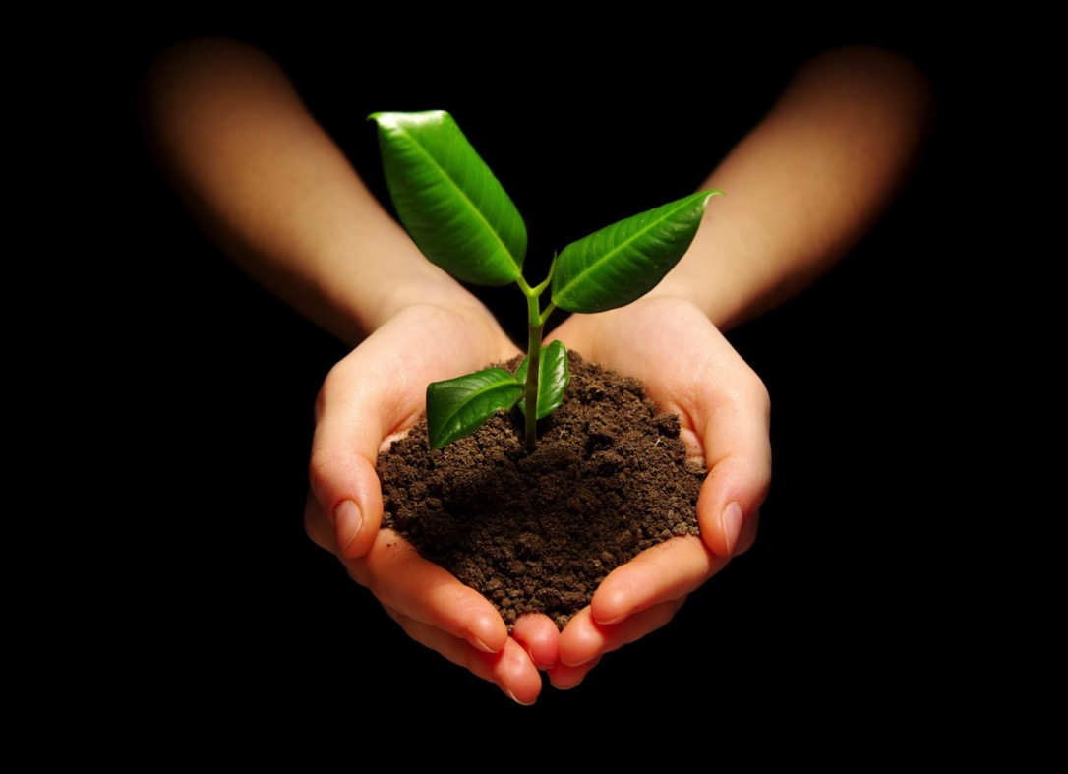
Let’s heal the Heart of the Canyon area now for ourselves, the land, the animals, and for future generations.

Slide 12
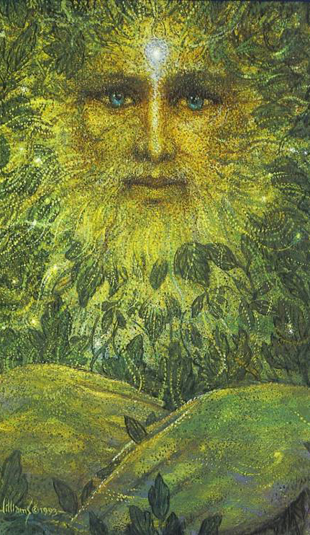
Let’s restore the natural habitat. We can plan for a mature and beautiful natural environment.

Slide 13
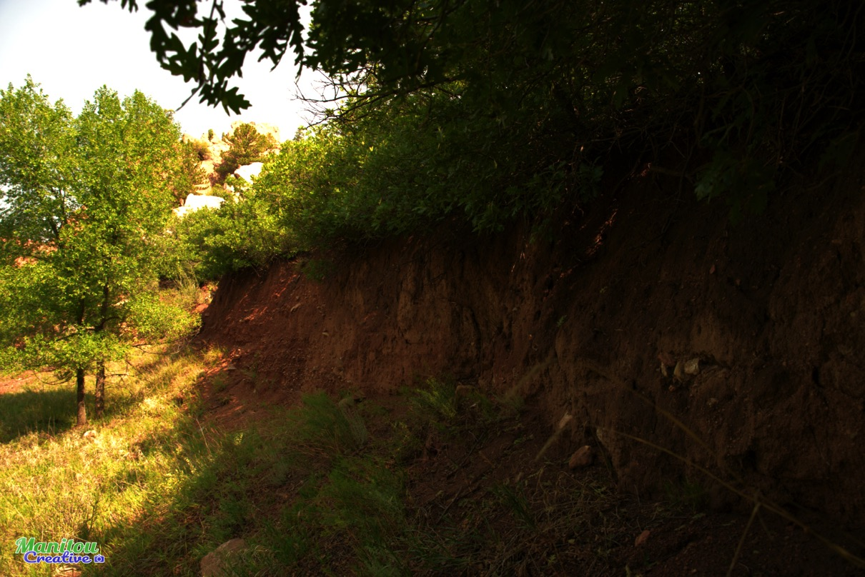
Let’s mitigate the quarry damage
and hide the discarded concrete.

Slide 14
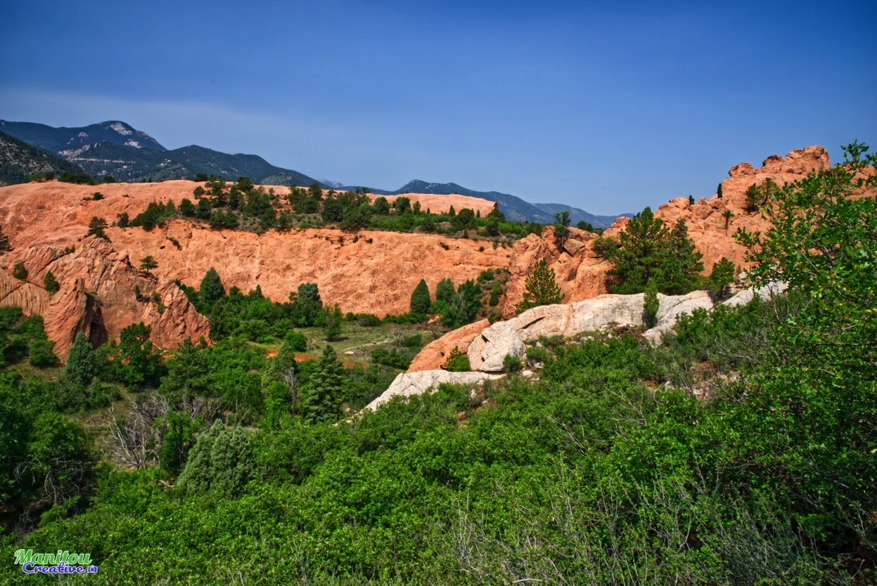
Let’s show the beauty of The Heart of the Canyon.
It is green and shady, due to the abundance of water.

Slide 15
Community engagement helped make Red Rock Canyon. Hundreds of citizens worked with the City to make the Master Plan.

Slide 16
A sustainable Heart of the Canyon trail is in the Master Plans of 2003 and 2013 because people wanted it.

Slide 17
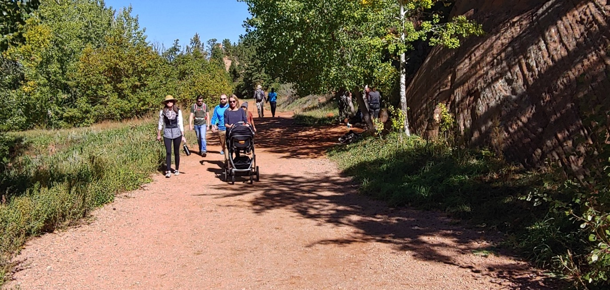
The Heart of the Canyon Trail is needed
and would be used by so many people.

Slide 18
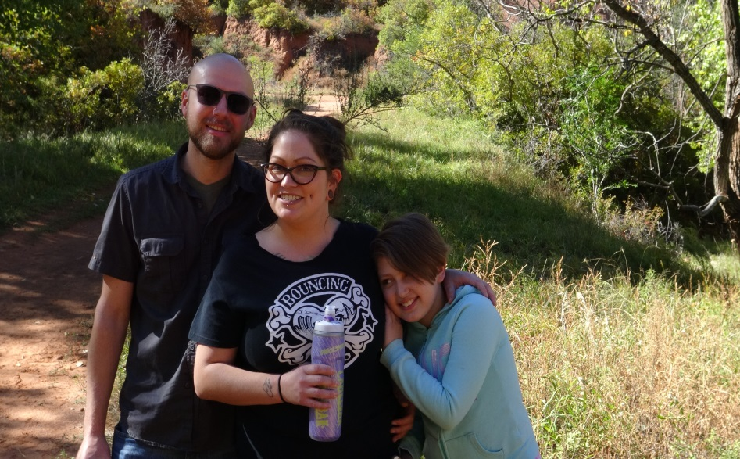
In RRCOS we use trails for a period of time, not to get somewhere. Most visitors go for 1 to 2.5 hours.

Slide 19
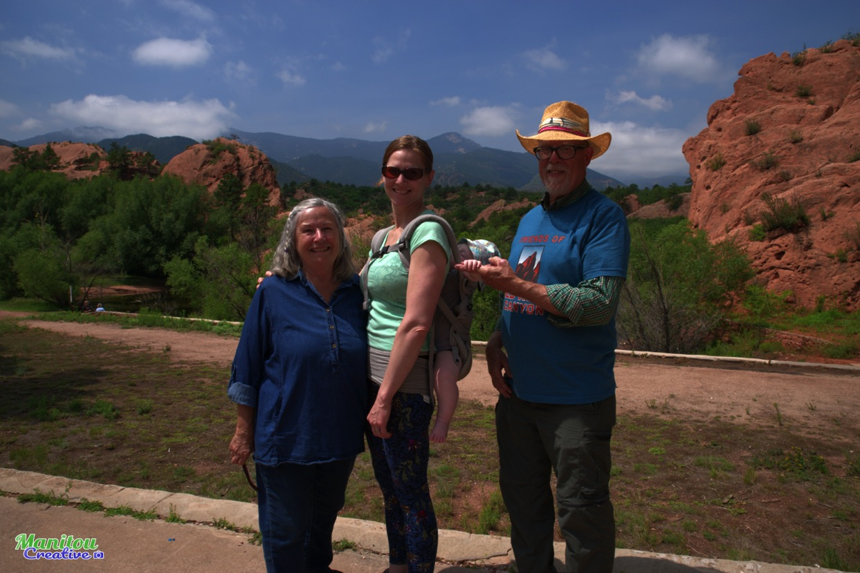
The trail would be part of the prettiest short loop.
People with limited time need that.

Slide 20
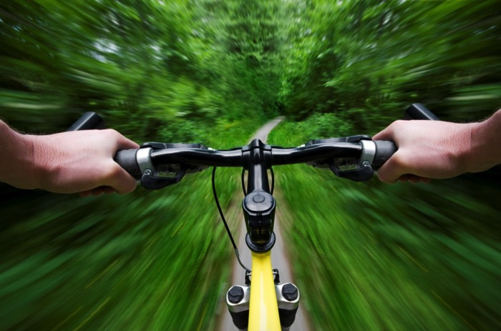
Residents and visitors come to see the beauty of nature.
Runners, hikers and bikers will all use the trail.

Slide 21
Families, the elderly, and the physically limited all want/need beautiful, short, and safe trail loops.

Slide 22
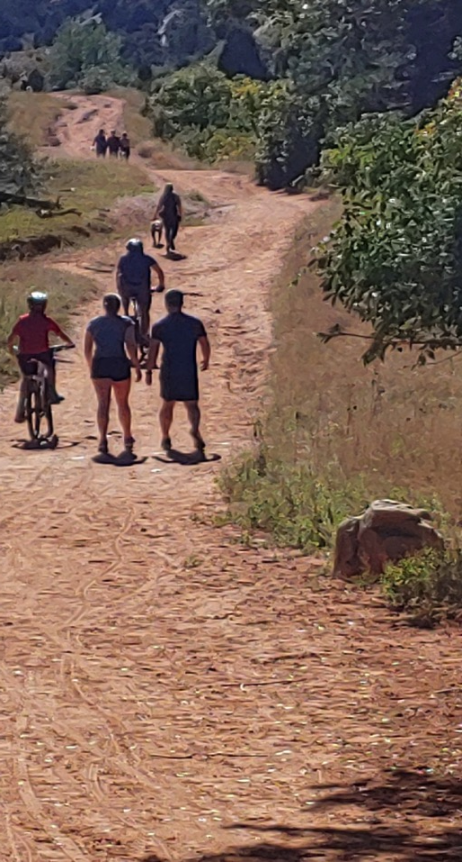
Presently, the trail requires people to go up this road, across the landfill and down the side of the landfill. The new trail is easier, shorter and prettier.

Slide 23
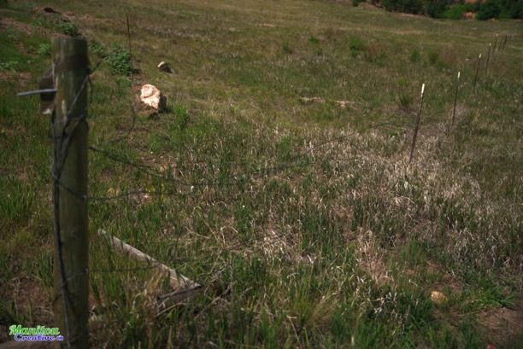
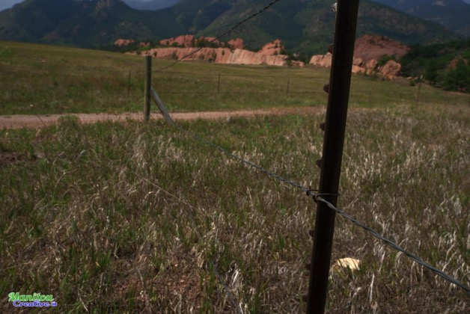
Why force people on to the dusty wire-fenced landfill, when better options are possible?

Slide 24
Just compare the environments of the two trails.

Slide 25
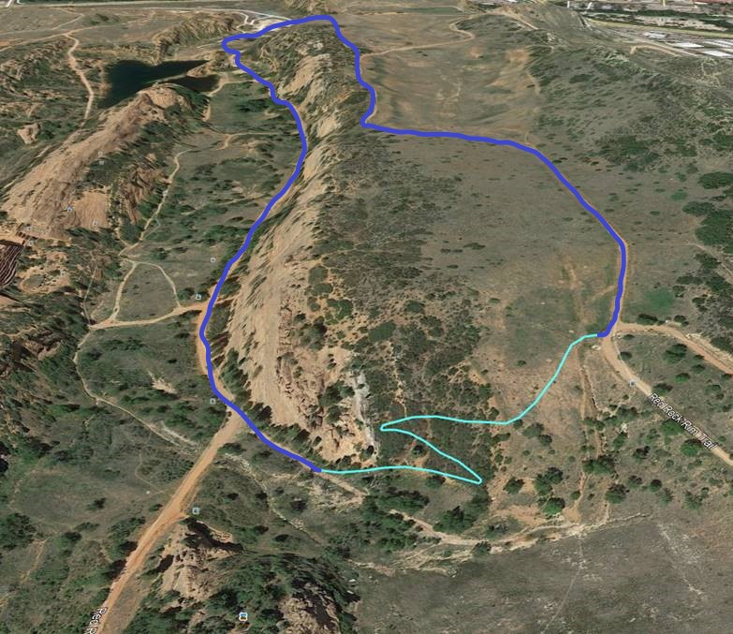
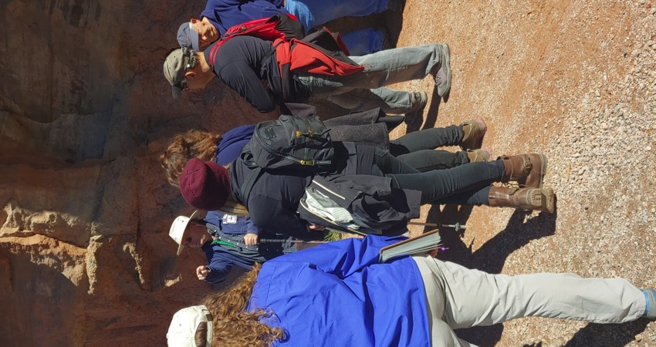
The new trail completes the geologic and historical educational walking loops suggested by UCCS and FoRRC .

Slide 26
Why avoid the issues and keep people from enjoying the trail? The problems will only get worse and cost more to fix later.

Slide 27
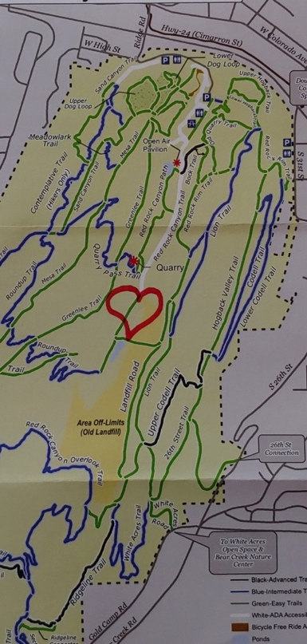
GOOD NEWS - There are at least 2 design options to build a multi–use trail through the Heart of the Canyon, which are sustainable and beautiful.

Slide 28
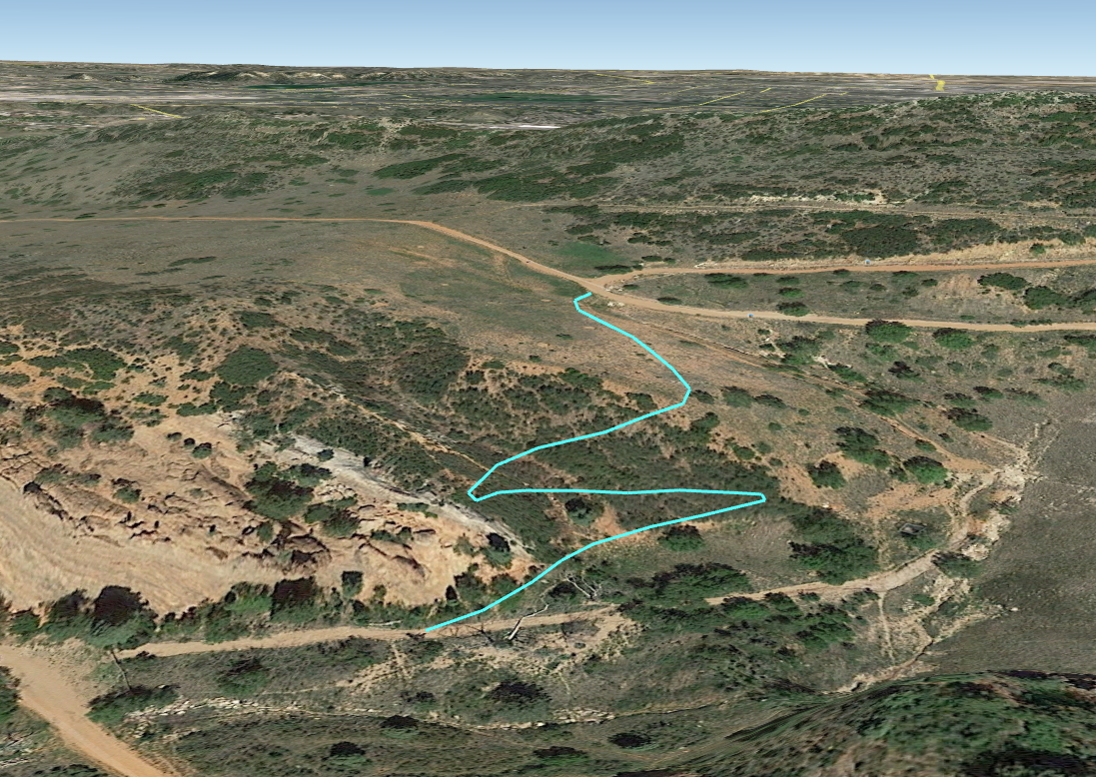
Trail option #1 (Harry Hamill from Medicine Wheel Trail Advocates)

Slide 29
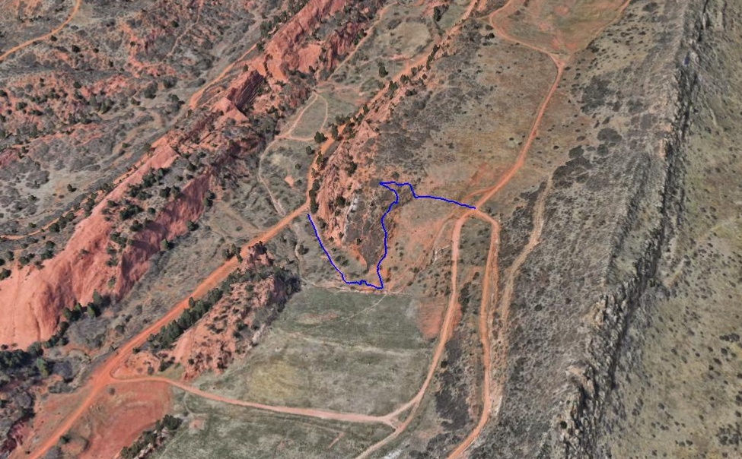
Trail option #2 (Mike Scott and Friends of Red Rock Canyon)

Slide 30
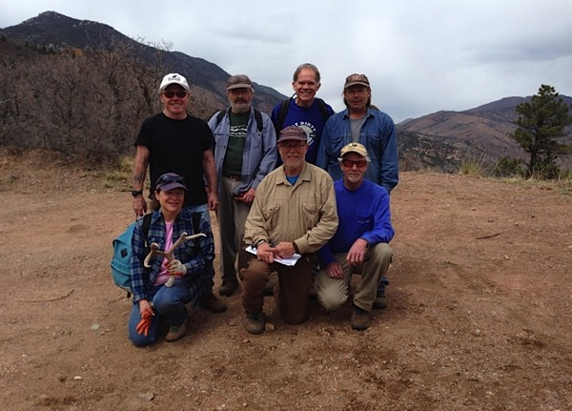
Volunteers want to help with the healing of the Heart of the Canyon.

Slide 31
FoRRC is committed and excited to build a Heart of the Canyon trail.

Slide 32
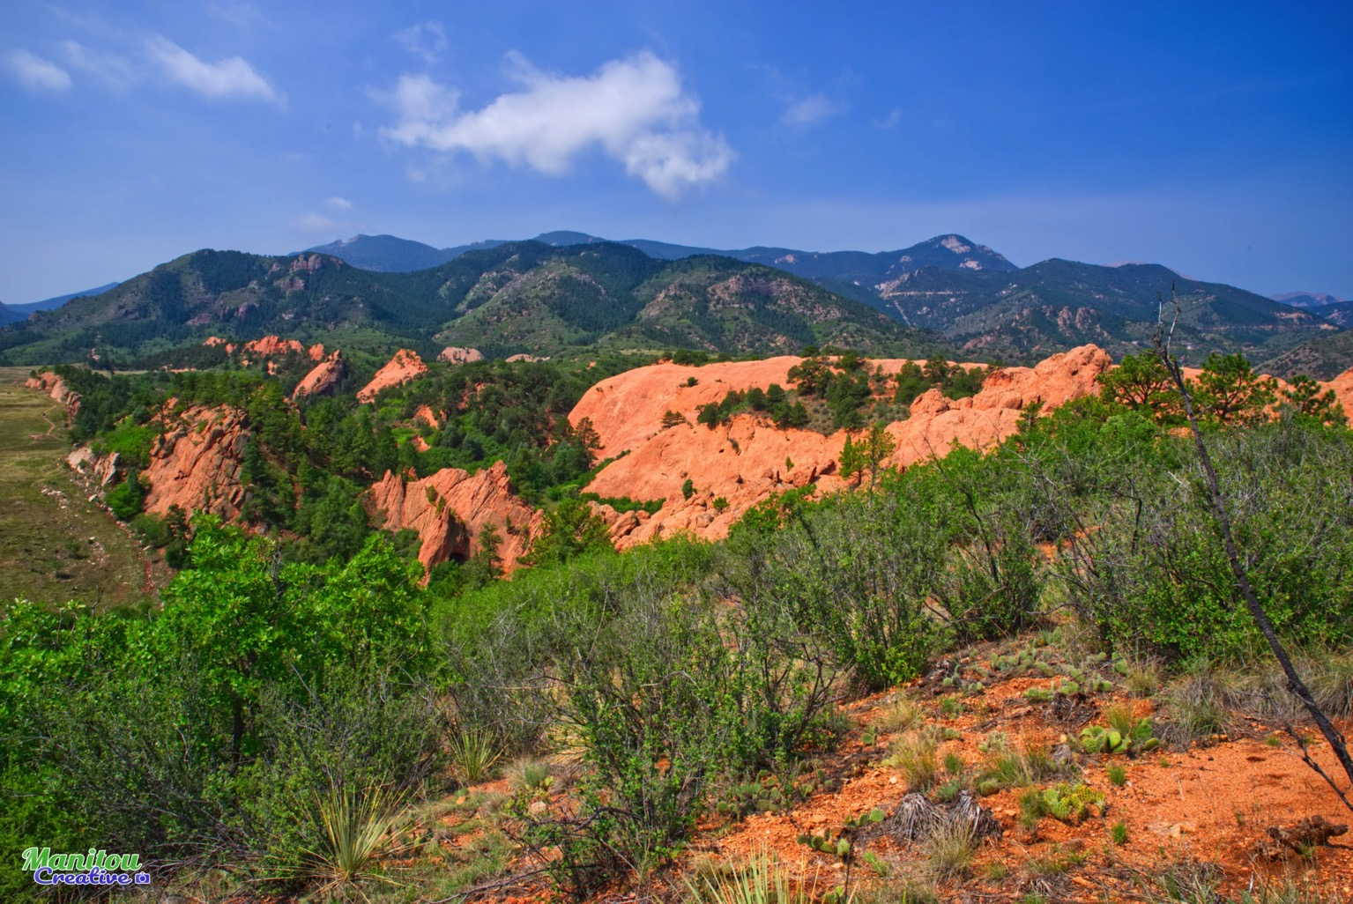
Let’s heal the Heart of the Canyon

Slide 33
Let’s heal the Heart of the Canyon.

Slide 34
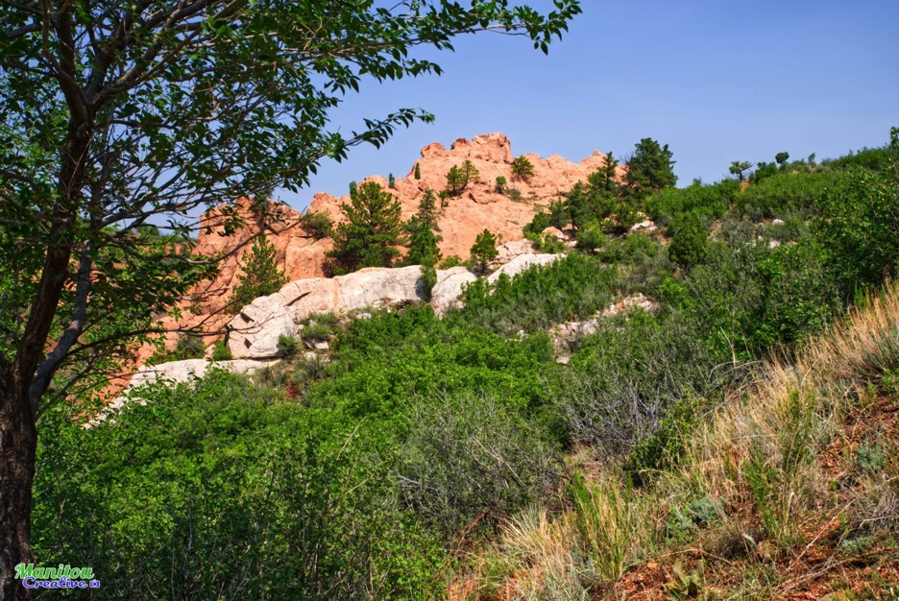
Heart of the Canyon Trail and Restoration Project
Friends of Red Rock Canyon -Presentation November 7, 2018
Created by Shanti Toll, Jeff Johnson, and Jenny Montague.
Photography by Jared Thompson and friends
Music “Day in the Canyon” by Annie Garretson

Slide 35
Heart of the Canyon Trail and Restoration Project
Friends of Red Rock Canyon -Presentation November 7, 2018
Created by Shanti Toll, Jeff Johnson, and Jenny Montague.
Photography by Jared Thompson and friends
Music “Day in the Canyon” by Annie Garretson

Slide 36
Heart of the Canyon Trail and Restoration Project
Friends of Red Rock Canyon -Presentation November 7, 2018
Created by Shanti Toll, Jeff Johnson, and Jenny Montague.
Photography by Jared Thompson and friends
Music “Day in the Canyon” by Annie Garretson

Slide 37
Heart of the Canyon Trail and Restoration Project
Friends of Red Rock Canyon -Presentation November 7, 2018
Created by Shanti Toll, Jeff Johnson, and Jenny Montague.
Photography by Jared Thompson and friends
Music “Day in the Canyon” by Annie Garretson

